Slide 1
Installation Guide
(Eclipse Plug-in － Properties Editor 5.0.0)
2008. 12. 16
CODELABOR
Shin Sang Jae (codelabor@gmail.com)

Slide 2
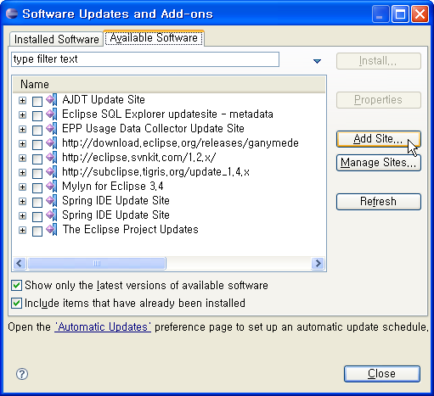
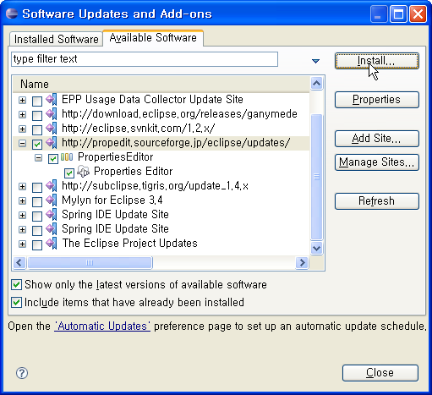
Eclipse Plug-in
Download
Eclipse Properteis plug-in
Official Site URL: http://propedit.sourceforge.jp/
Eclipse update site URL: http://propedit.sourceforge.jp/eclipse/updates/

Slide 3
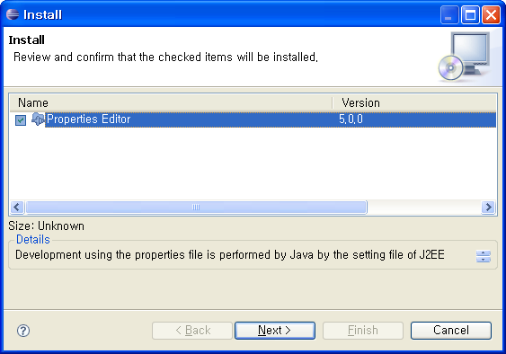
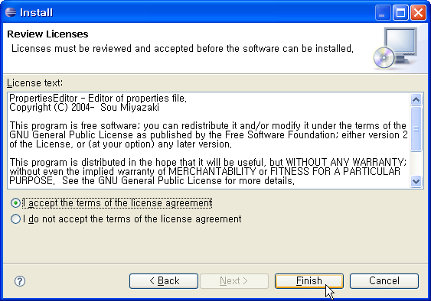
Eclipse Plug-in
Download
Accept the terms of the license agreement

Slide 4
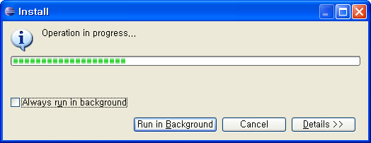
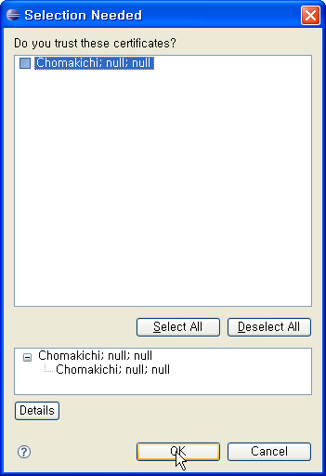
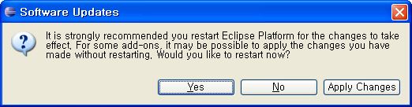
Eclipse Plug-in
Download
Trust certificates

